Slide 1

Chicago Crime Analysis Project
Education and Criminal Incidents

Slide 2
Introduction
The main purpose of this project is to examine the relationship between education and criminal incidents in Chicago
Specifically, this project tries to visualize if public elementary schools who had the lowers academic achievements were in/near areas where more criminal accidents were reported
This project could suggest potential risks that students in those elementary schools have been facing, and could be utilized to propose policy changes in order to protect children’s safety and to improve their leaning environment

Slide 3
data
The school dataset was obtained from “Chicago Public Schools Progress Report Cards (2011-2012)”:
https://data.cityofchicago.org/Education/Chicago-Public-Schools-Progress-Report-Cards-2011-/9xs2-f89t?cm_mmc=Email_Newsletter-_-Developer_Ed%2BTech-_-WW_WW-_-SkillsNetwork-Courses-IBMDeveloperSkillsNetwork-DB0201EN-SkillsNetwork-20127838&cm_mmca1=000026UJ&cm_mmca2=10006555&cm_mmca3=M12345678&cvosrc=email.Newsletter.M12345678&cvo_campaign=000026UJ
The crime dataset was from 2012, and was obtained from Chicago Data Portal:
https://data.cityofchicago.org/Public-Safety/Crimes-2001-to-Present/ijzp-q8t2

Slide 4
Data-continued
462 elementary schools in the dataset
4 variables were chosen as “academic achievements”
Gr3-5 Grade Level Math % : % of students at grade level, math, grades 3-5
Gr3-5 Grade Level Read % : % of students at grade level, reading, grades 3-5
Gr3-5 Keep Pace Math % : % of students meeting growth targets, math, grades 3-5
Gr3-5 Keep Pace Read % : % of students meeting growth targets, reading, grades 3-5
11 schools were missing those variables
Deleted those 11 schools, so the dataset included 451 schools in total

Slide 5
methods
Descriptive analysis was conducted to see summary statistics of public elementary schools in Chicago
K means clustering was conducted to divide the schools into four groups, based on the academic achievement variables
Selected the first 1,000 incidents from the crime dataset (since the original dataset was too big for this analysis), and then a created choropleth map that shows color differences based on numbers of incidents occurred in each community (e.g., darker colors mean more incidents, and lighter colors means less incidents)
Plotted the schools who had the lowest academic achievements and those who had the highest academic achievements on the choropleth map, which would visualize if the schools that have the lowest/highest academic achievements are in areas where more/fewer incidents were reported

Slide 6
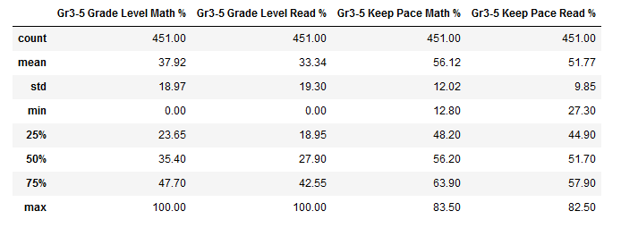
Descriptive analysis

Slide 7
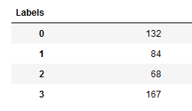
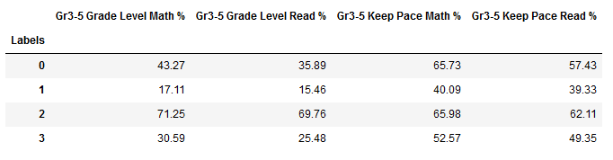
K means clustering dividing the schools into four groups based on academic achievements
Numbers of Schools in Each Group
Descriptive Analysis of the Four Groups
Group 1 has the lowest academic achievements, and Group 2 has the highest academic achievements

Slide 8
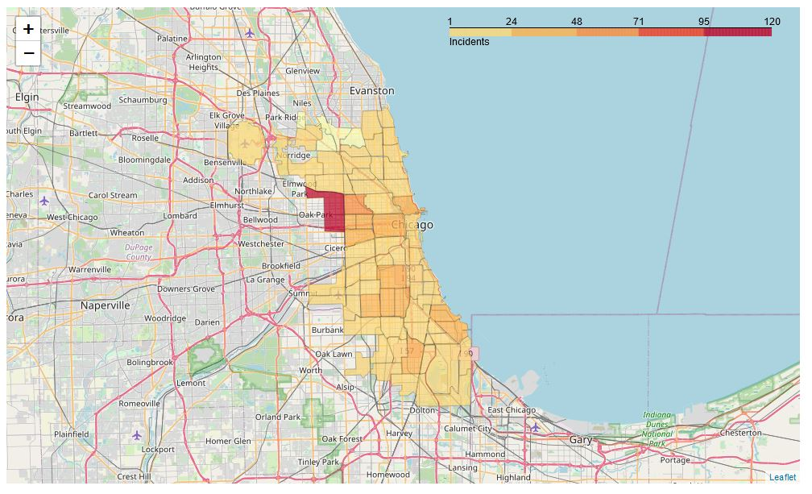
Choropleth map
Darker colors mean more incidents occurred

Slide 9
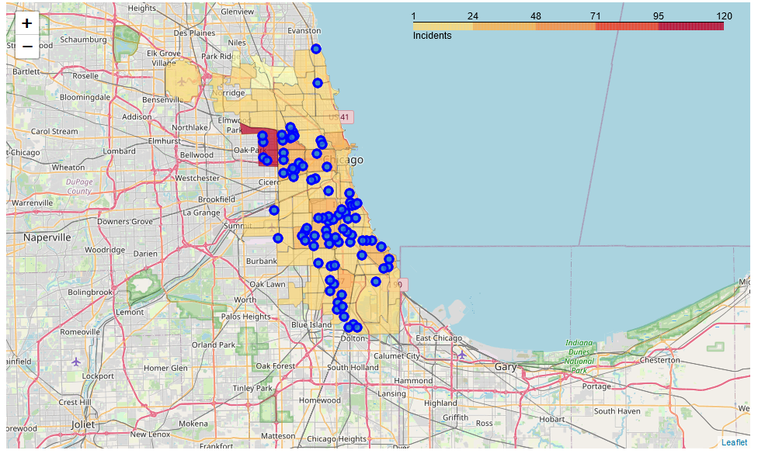
Locations of the schools that had the lowest academic achievements
In general, those schools are in darker-colored areas
4 schools are in “red” areas, which is very concerning

Slide 10
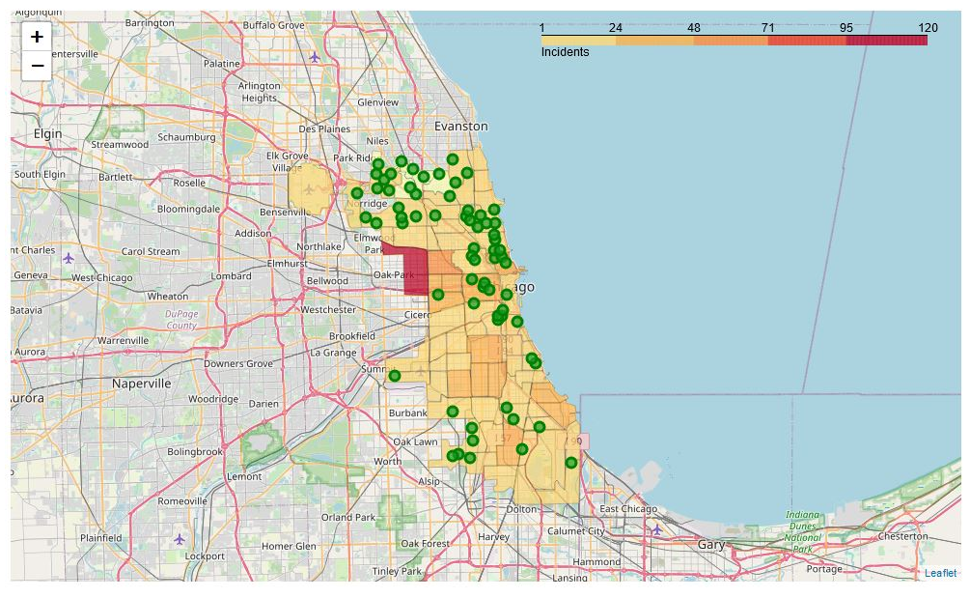
Locations of the schools that had the highest academic achievements
In general, those schools are in lighter-colored areas
None of them are in the “red” areas

Slide 11
summary
The schools that had the lowest academic achievements were more in the “darker-colored areas” or areas where more incidents occurred
The schools that had the highest academic achievements were more in the “lighter-colored areas” or areas where fewer incidents occurred
This project identified potential relationships between criminal incidents and educational achievements
This project also suggested potential risks that the students at the low academic achievement schools may have been facing
This project could be utilized to target those who are in the vulnerable communities, and provide necessary resources, assistance, and guidance

Slide 12
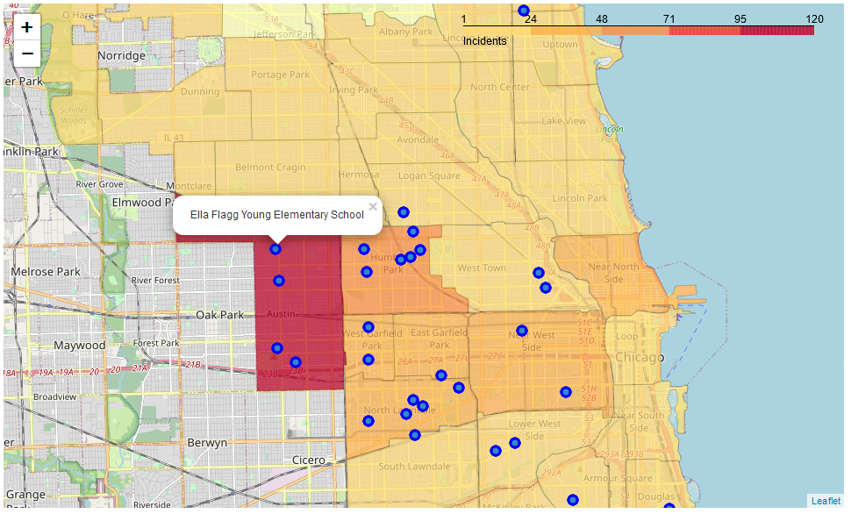
note
Full maps are available from the websites below (nbviewer). You can zoom in/out those maps, and you can see names of each elementary school by clicking the blue/green dots on those maps
https://nbviewer.org/github/Fuse0210/Chicago-Analyses-Crime-and-Education/blob/main/Crime%20and%20Education%20%28ES%29.ipynb
Sample Image
You can see all the Python codes that were used for this project on my Github page below (please note that the Table of Contents and the maps do not work properly on the Github page. Please go to the nbviewer website above to see those maps):
https://github.com/Fuse0210/Chicago-Analyses-Crime-and-Education/blob/main/Crime%20and%20Education%20(ES).ipynb

